Slide 1
Tensorflow Fundamentals

Slide 2
What exactly does TensorFlow do?
Why can’t I use Python for Deep Learning?
Python’s Inefficiencies
Dynamically typed language.
Arrays are impossible to use after a certain size
Index keeping is done because of different data type within lists.
[1,”this”,[1,2,3], ”is”, ”not”, ”good”] is a valid python list.

Slide 3
Enter Numpy
Fast Numeric computations
Introduced NumPy Array
Same datatype – Compact storage, Faster Access
Optimized operations implemented in C
Fast Matrix Multiplications
SciPy and Pandas
Good for general purpose machine learning.

Slide 4
Disadvantages of Numpy
Each operations has to talk to numpy’s c code and Python Interpreter
E.g. Print, Logging
The classic algorithm for training a deep model is (stochastic) gradient descent using backpropagation, which requires taking lots of derivatives.
Automatically computing the derivative of some formula requires having some representation of that formula in memory.

Slide 5
Enter TensorFlow
TensorFlow had the idea of computation graph.
In TensorFlow, in pure Python, an object-oriented representation of the entire computation she wishes to perform is made.
This representation is called a "graph“
Building a graph is like writing a formula, no actual calculation is done.
Lightweight and fast.
TensorFlow can do the necessary calculus automatically, computing gradients based on the structure of that graph.

Slide 6
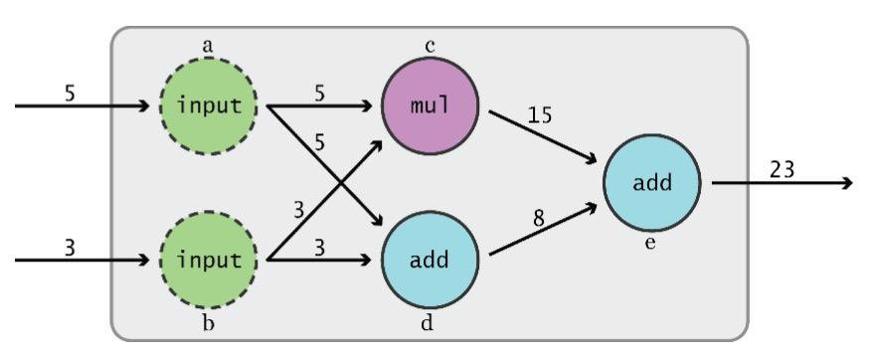
Computational Graph
Nodes = “Operations”
Edges = “Data”
This is also called a Dataflow Diagram

Slide 7
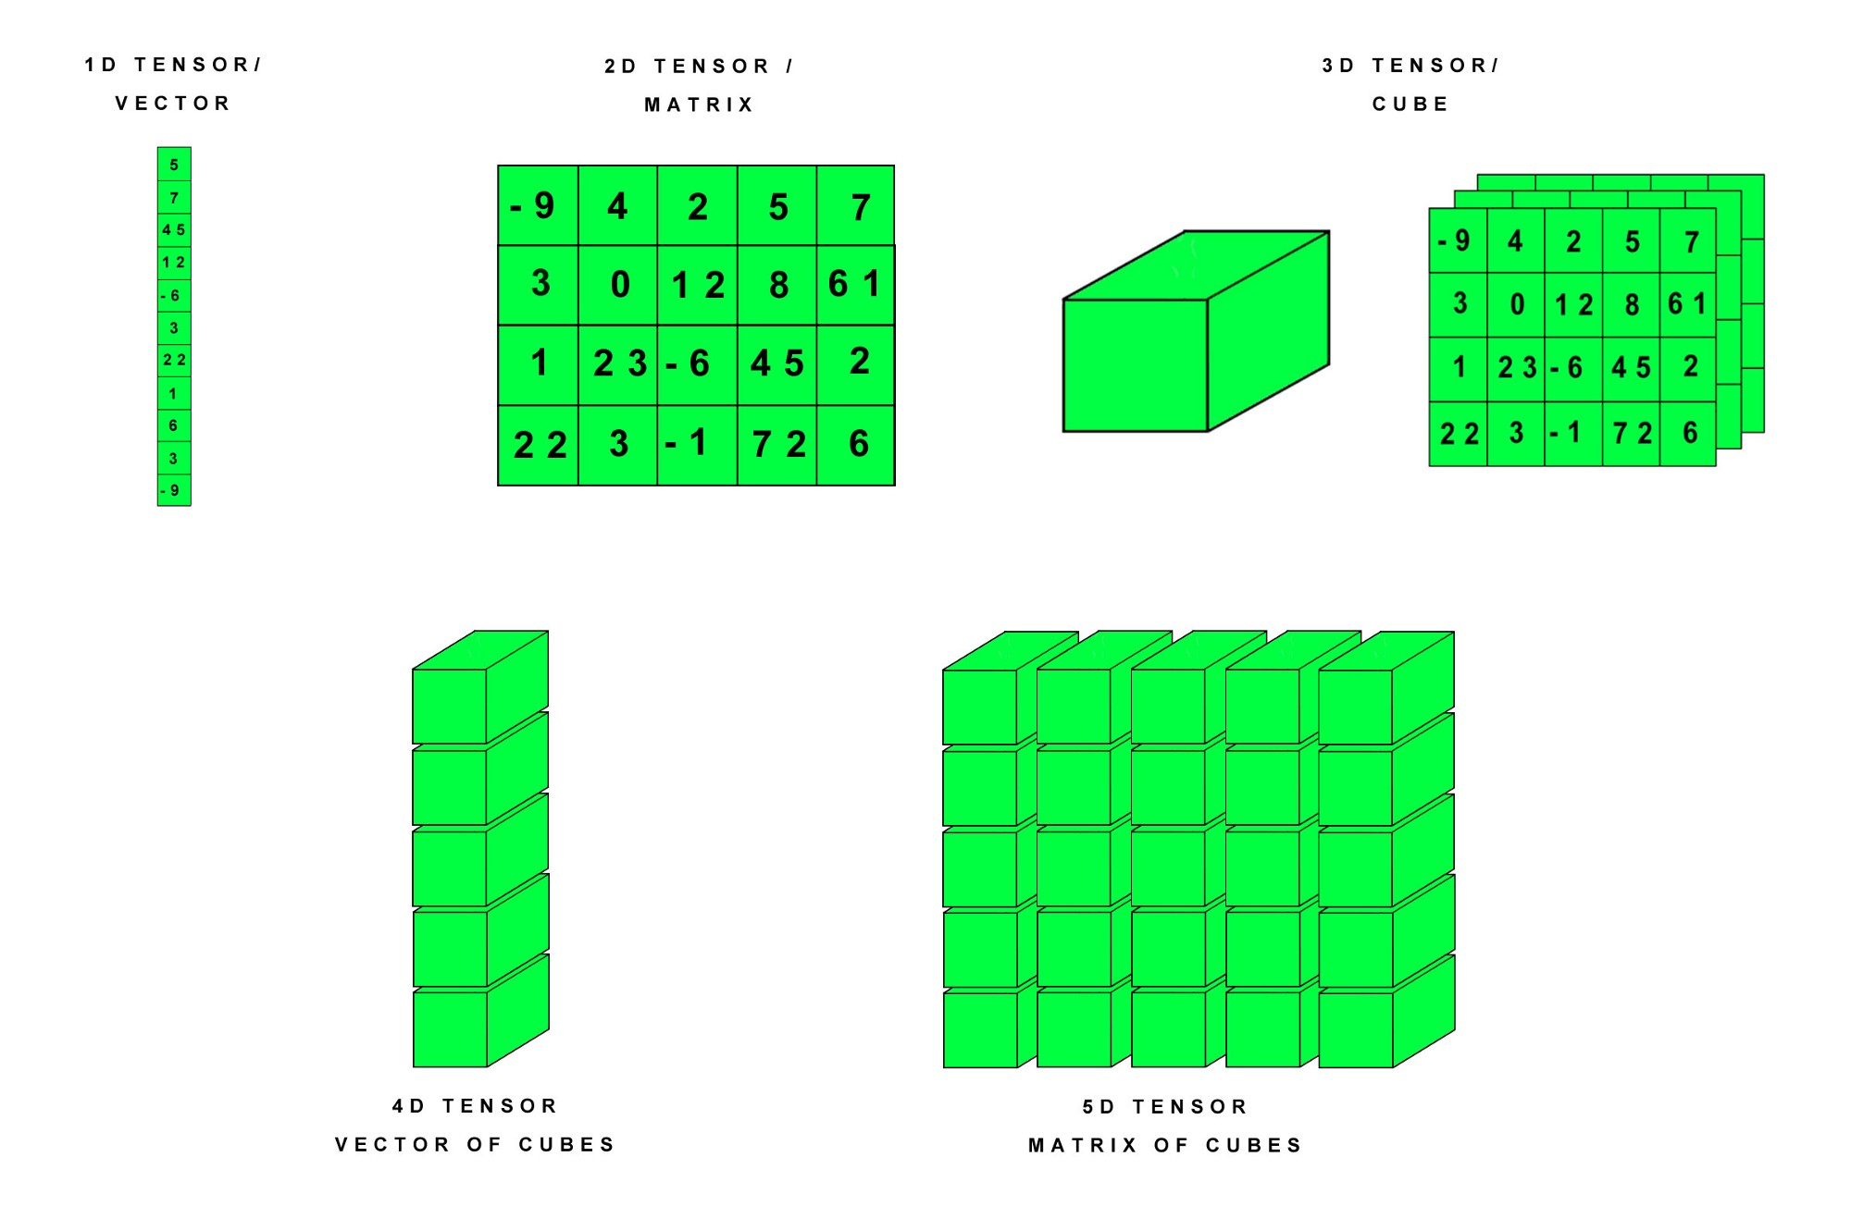
What’s a Tensor?
An n-dimensional array
0-d tensor: scalar (number)
1-d tensor: vector
2-d tensor: matrix and so on

Slide 8
How Tensorflow Works
Define Computational graph in Python
Graph stored in memory
C/C++ code runs the graph and returns the results

Slide 9
Step 1 : Google Collaboratory
colab.research.google.com

Slide 10
Step 2 : Initial Configuration
Create a new Python3 Notebook
Go to Runtime > Change Runtime Type > GPU

Slide 11
The default graph, operations, and tensors
import tensorflow as tf

Slide 12
Default graph
g = tf.get_default_graph()
g
Notes:
Even before you call your first TensorFlow function, a lot is going on behind the scenes.
For example, an empty default graph object is created
In order to fully understand what's happening in your program, you need to know that these state variables, like "current graph" and "current scope" and "current session", exist.
As we'll soon see, most of the functions you'll call in TensorFlow operate by quietly accessing this hidden state.

Slide 13
Operations
First,
g.get_operations()
In the next cell,
tf.constant(3.14)
g.get_operations()
Notes:
An **operation** is a _node_ of the computation graph. It contains only some light metadata, like "I am an addition operation, and my inputs come from these two other operations.
Again, all this computation happens after the graph has been completely built, description of what operation will take place

Slide 14
Operations
First,
const_operation = g.get_operations()[0]
len(const_operation.inputs), len(const_operation.outputs)
In the next cell,
const_tensor = const_operation.outputs[0]
const_tensor
Notes:
Every operation takes in some number of inputs (0 or more), and produces 0 or more outputs. Its outputs can become the inputs to other operations
Perhaps the simplest operation we can create is constant. It has zero inputs and one output.

Slide 15
Hence:
return “TensorFlow” If Data==Tensor in Dataflow”
Notes:
A Tensor is a lightweight Python object that represents a piece of data flowing along the edges of our graph. That data can be a scalar, a vector, a matrix, or a higher-dimensional array.
The tensor's data is not actually stored inside the Tensor object, and in fact does not exist in Python at all. t does not know it will refer to the value 3.14. A Tensor is just a lightweight way to reference a piece of data that will be computed by TensorFlow's execution engine.

Slide 16
Operations
First,
another_const_tensor = tf.constant(1.414)
another_const_tensor
In the next cell,
g.get_operations()
Notes:
Every operation takes in some number of inputs (0 or more), and produces 0 or more outputs. Its outputs can become the inputs to other operations
Perhaps the simplest operation we can create is constant. It has zero inputs and one output.

Slide 17
Operations
First,
sum_tensor = tf.add(const_tensor, another_const_tensor)
sum_tensor
In the next cell,
g.get_operations()

Slide 18
Operations
First,
add_op = g.get_operations()[2]
In the next cell,
len(add_op.inputs),len(add_op.outputs)

Slide 19
Running computations
In order to execute your computation graph, you need to create a Session object.
A Session object stores a reference to the graph to execute, some configuration information
You can create a session using the tf.Session constructor.
It can take in a graph parameter, but if you omit it, the session will use the default graph.
Notes:
(determining, for instance, how much memory TensorFlow should allocate on your GPU), and storage for stateful components of your computation graph.

Slide 20
Running computations
First,
sess = tf.Session()
In the next cell,
sess.graph == g

Slide 21
Running a session
The run method of the Session class is used to send your graph to the computation engine and execute it.
As an argument, we pass a tensor we'd like to "fetch" the value of.
Based on which tensor we'd like to compute, TensorFlow will calculate a path through the graph, and then execute only the parts of the graph necessary to compute our desired tensor.

Slide 22
Running computations
sess.run(sum_tensor), sess.run(const_tensor), sess.run(another_const_tensor)
Notes:
Above, we call sess.run three times, which invokes the execution engine three times. There is no memoization; each time you call sess.run, everything is computed anew. Because of this, if you want to fetch more than one tensor, it's more efficient to fetch them all in one go, by passing a list to sess.run. You can also pass a dictionary, a tuple, a named tuple, or nested combinations of these data structures.

Slide 23
Running computations
sess.run([sum_tensor, const_tensor, another_const_tensor])
Or
sess.run({'a': const_tensor, 'b': another_const_tensor, '[a,b,a+b]': [const_tensor, another_const_tensor, sum_tensor]})

Slide 24
Finally
sess.close()
Sessions are more powerful than this, but to understand why, we need to talk about placeholders and variables.

Slide 25
Placeholders
Our program above is a bit rigid.
If we wanted to perform the exact same addition calculation on different inputs, we would need to create a whole new trio of operations; we have no power to abstract.
Placeholders fix this.
A placeholder operation, just like a constant, has 0 inputs and 1 output.
However, instead of fixing the output value when you define the operation, we pass the placeholder's value to sess.run when executing the graph.
This allows us to execute the same graph multiple times with different placeholder values.

Slide 26
Placeholders
First,
a = tf.placeholder(tf.float32)
a
Next,
b = tf.placeholder(tf.float32)
flexible_sum_tensor = tf.add(a, b)
g.get_operations()

Slide 27
Placeholders
First,
sess = tf.Session(config=config)
Next,
sess.run(flexible_sum_tensor, feed_dict={a: 1., b: 2.})

Slide 28
Placeholders
When we call sess.run, we now pass in a second argument, feed_dict.
This is a Python dictionary in which the
Keys are placeholder tensors
Values are numbers, numpy arrays, or Python lists.
Note that the keys of feed_dict are the actual tensor objects, not strings.

Slide 29
Placeholders
First,
sess.run(flexible_sum_tensor, feed_dict={a: [1.], b: [2.]})
Next,
sess.run(flexible_sum_tensor, feed_dict={a: [[1., 2.], [3., 4.]], b: [[5., 6.], [7., 8.]]})

Slide 30
Placeholders
First,
sess.run(flexible_sum_tensor, feed_dict={a: [1.], b: [2.]})
Next,
sess.run(flexible_sum_tensor, feed_dict={a: [[1., 2.], [3., 4.]], b: [[5., 6.], [7., 8.]]})

Slide 31
A few things to note:
1. We were able to fetch the same tensor multiple times but with different feed_dict arguments.
2. The placeholder's dimension is dynamic. (You can optionally specify a static dimension when defining a placeholder, by passing a `shape` argument to `tf.placeholder`.)
3. The add operation works much like numpy's add operation, in that it can add (element-wise) two multidimensional arrays.
4. When asked to fetch an array (single- or multi-dimensional), TensorFlow returns a numpy array.

Slide 32
A few things to note:
Python arithmetic operators (+, −, /, ∗) are overridden for the Tensor type.
Evaluating the expression a+b, where a and b are tensors, has the side effect of adding an Add operation to the default graph with a and b as inputs.
The result of evaluating a+b is the output tensor of that add operation.
This makes it easy to add many nodes quickly. For instance,

Slide 33
Python Arithmetic
First,
g.get_operations()
Next,
distance_from_origin = tf.sqrt((a * a) + (b * b))
g.get_operations()

Slide 34
Python Arithmetic
First,
distance_from_origin
Next,
sess = tf.Session(config=config)
sess.run(distance_from_origin, feed_dict={a: 3., b: 4.})

Slide 35
Finally
sess.close()
Alternatively,
with tf.Session() as sess:
print(sess.run(distance_from_origin, feed_dict={a: 9., b: 12.}))

Slide 36
Our graph is getting a bit crowded
tf.reset_default_graph()
g.get_operations()
Whoa!!!!
g = tf.get_default_graph()
g.get_operations()

Slide 37
Variables
Like constants and placeholders, variable operations take 0 inputs and produce 1 output. The big difference is that a variable is mutable and persistent across runs of your graph
Constant's value is fixed when creating the graph.
Placeholder's value is set anew each time you call sess.run.
Variable's value is set or changed while the graph is running.

Slide 38
Variables
First,
g.get_operations()
Next,
x = tf.Variable(42)
[(op, "{} inputs and {} output".format(len(op.inputs), len(op.outputs))) for op in g.get_operations()]

Slide 39
Variables
First,
sess = tf.Session(config=config)
Next,
sess2 = tf.Session(config=config)
Finally,
sess.run(x)

Slide 40
Error!!
"Attempting to use uninitialized value Variable."
In order to initialize the variable, we actually have to run the assign op that was created for us. Recall that this was the third operation in the graph.

Slide 41
Variables
First,
sess.run(g.get_operations()[2])
Next,
sess.run(x)
Finally,
sess2.run(x)

Slide 42
Let’s fix that
First,
sess2.run(x.initializer), sess2.run(x)
Variable objects have an initializer property that refers to the Assign operation that gives them their initial value.
Fetching an operation instead of a tensor performs its side effect but returns None -- even if the operation has an output.

Slide 43
Finally
First,
sess.close()
sess2.close()
Next,
tf.reset_default_graph()
g = tf.get_default_graph()

Slide 44
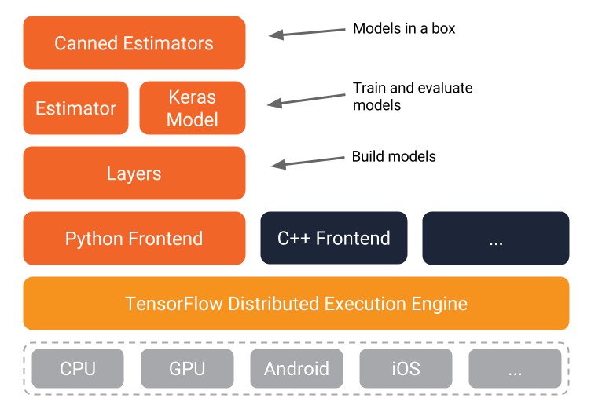
How Tensorflow is like JVM

Slide 45
Implementing a Supervised Learning Model

